Slide 1

VIRTUAL AI-ASSISTANT
- By Paa Bhai.

Slide 2

VIRTUAL AI-ASSISTANT.
Free of cost with source code.
Beginner friendly and optimizable project.
Save playlist, subscribe, like and follow.
Free raw Materials used in project.
‹#›
1
2
3
4

Slide 3



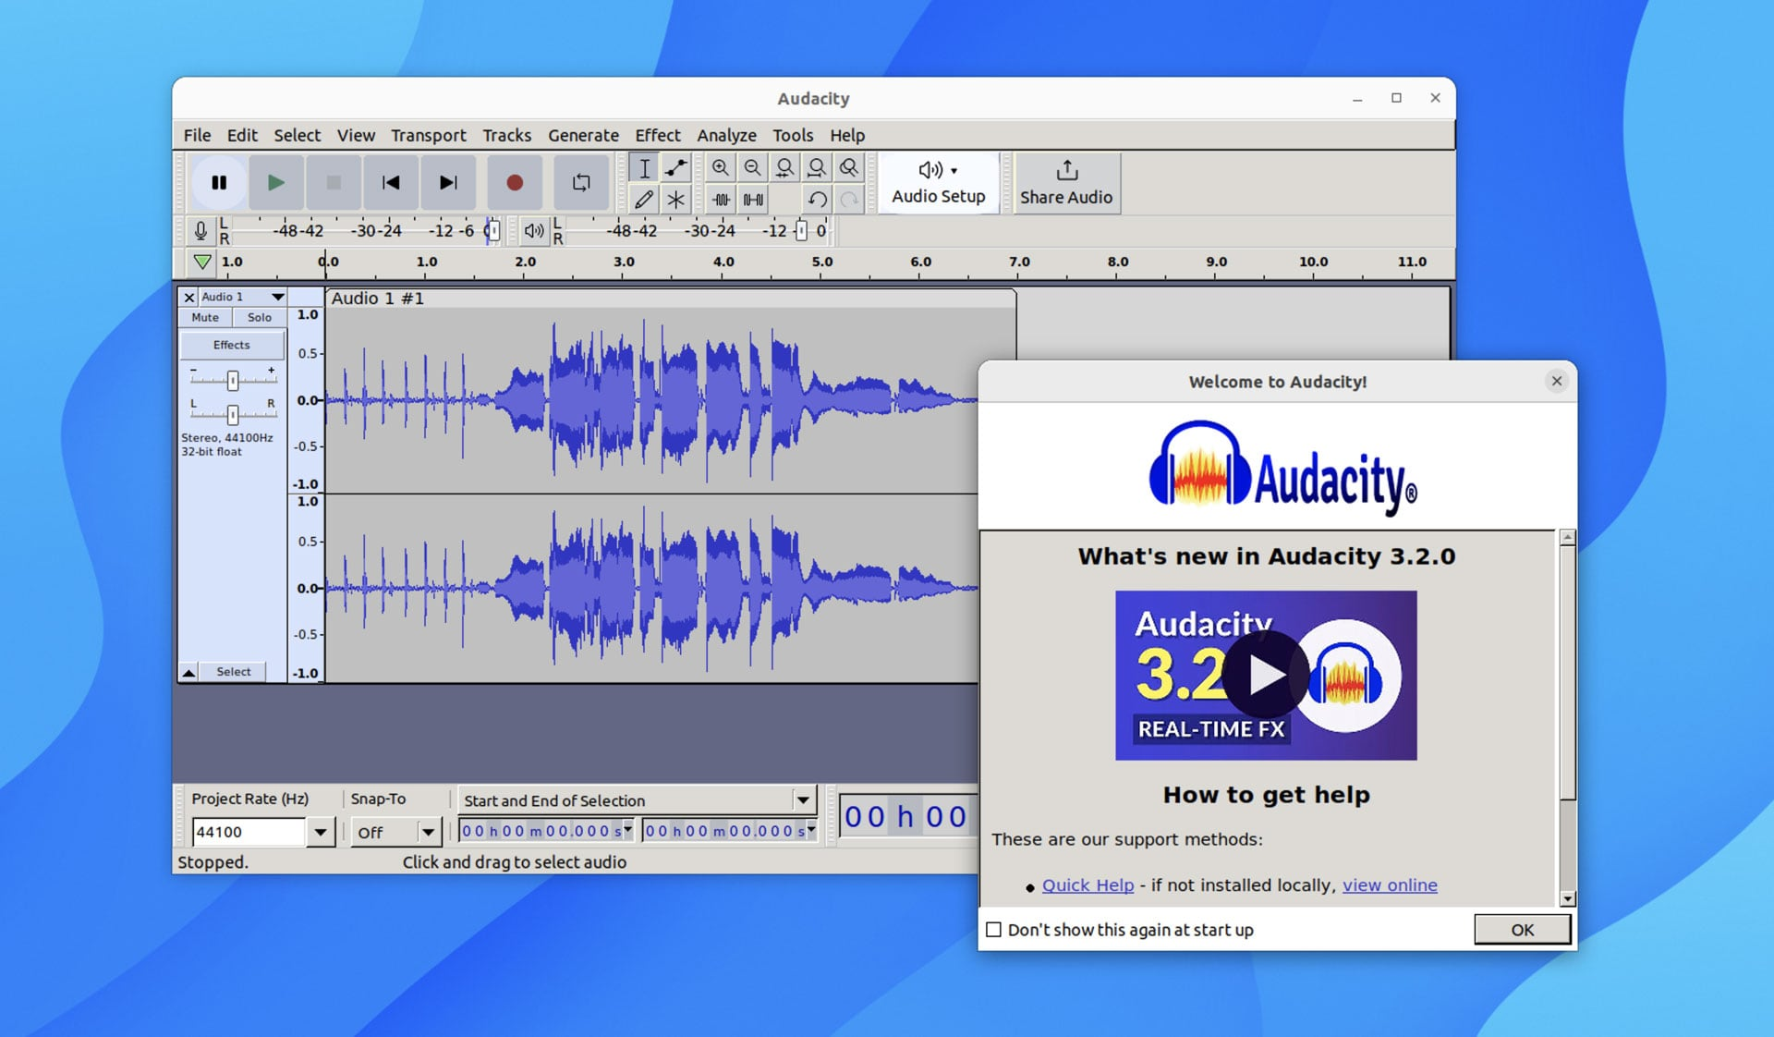
VS Code-: A Source code editor with built-in debugging, Git integration, and extensions.
Python-: A high-level, programming language known for simplicity, readability, and versatility, used in web development, data analysis, scientific computing, and AI applications.
Qt-Designer-: A User interface tool to create interfaces using widgets, supports Python bindings that easily integrate with Python backend code.
Audacity-: A free, open-source audio editing and recording software that provides features for editing, recording, and analyzing audio files.
‹#›

Slide 4


EXISTING AI-ASSISTANTS
An AI-Assistant is an interface to perform humanly tasks.
Google-: Google Assistant.
Apple-: Siri.
Microsoft-: Cortana.
Amazon-: Alexa.
‹#›
1
2
3
4
5

Slide 5

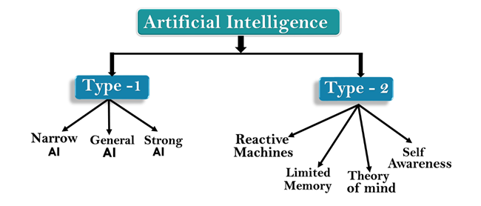
TYPES OF AI
1
Narrow AI- weak, scripted.
General AI- powerful, intelligent, learn from experience, reason, plan and process Natural Language.
Strong AI- Hypothetical, exceeds human capabilities.
2
3

Slide 6

Parts of Project Series-:
1
Part(0)-: Introduction, Resource download, Project Demo.
Part(1)-: Sensory Installation.
Part(2)-: AI-Brain.
Part(3)-: User Interface.
Part(4)-: Functionalities.
2
3
4
5

Slide 7
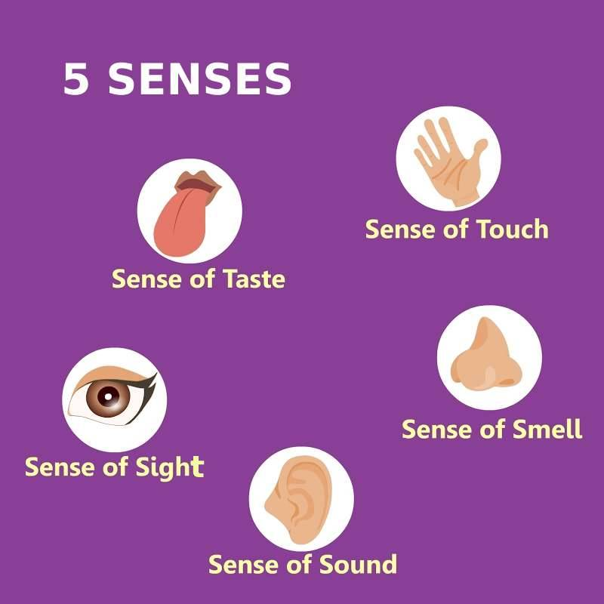
PART 1 : SENSORY INSTALLATION
1
IMAGE RECOGNITION.
2
SPEECH RECOGNITION-:
1.Speaking Function.
2.Listening Function.

Slide 8
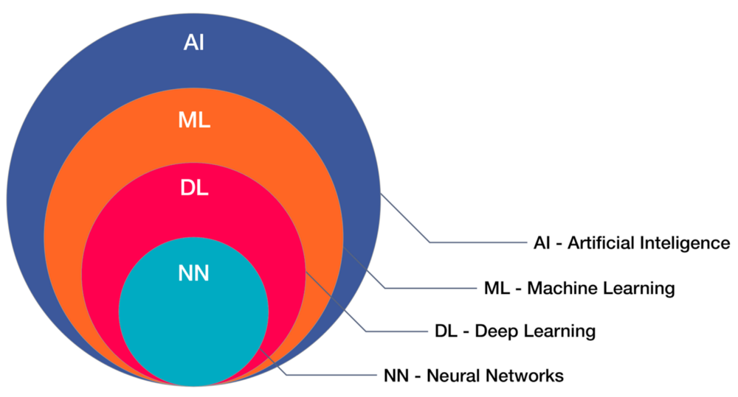
PART 2 : AI-BRAIN
1
NARROW AI-: Weak, Scripted.
2
GENERAL AI-: General AI- powerful, intelligent, learn from experience, reason, plan and process Natural Language.

Slide 9

PART 3 : User Interface

Slide 10
PART 4 : FUNCTIONALITIES
1
PRIMARY OR OS-BASED.
2
SECONDARY OR INPUT BASED.
3
TERTIARY AUTOMATIONS.

Slide 11

THANK YOU !
SAVE PLAYLIST IN LIBRARY.
DOWNLOAD RESCOURCES.
SUBSCRIBE AND TURN BELL ICON.
LIKE THE VIDEO.
FOLLOW ME ON INSTAGRAM.
BINGE WATCH THE SERIES.
ADD PROJECT TO CV.
1
‹#›
2
3
4
5
6
7

